Slide 1




Face detection with opencv-rust
@Payne325
Alexander Payne
Payne325
PaynoInsano

Slide 2
What I set out to do
Had beginner level experience with Rust already
Wanted a project that had aims beyond “Learn Rust language features X, Y & Z”
Some experience with Computer Vision and Deep Learning with Python
Goal: Game with real-time face tracking to move the player

Slide 3
Why OpenCV?
Piston – A modular game engine written in Rust
  Has some image processing functionality available
  Still in development
  No plan to venture into serious computer vision
cv-rs – A hand crafted binding to the OpenCV Cpp Library
  Incomplete implementation
  Commit history suggests project was abandoned
opencv-rust – auto-generated bindings
  Requires user to install OpenCV manually
  Untested
  Full support for OpenCV functions and modular compilation

Slide 4
Developer Environment
Acquire the OpenCV library
  Windows: Recommended via package manager
  Linux: Recommended Compile from Source
Set the necessary system variables
  opencv-rust crate documentation didn't cover all the variables I needed
  Issue history suggests other developers have had different setup problems
  Setup process seems fragile
Requires installation of the libclang-dev or llvm package

Slide 5
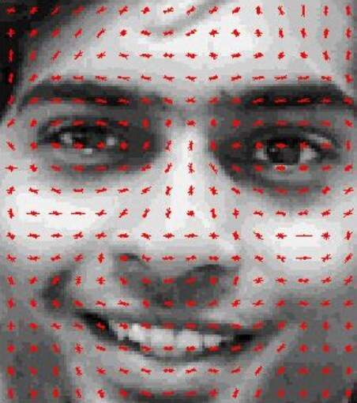
Approaches for Face Detection
Detect Facial Landmarks using H.O.G.s
Feature descriptors derived from distribution of intensity gradients within the image
Descriptors passed to a suitable ML model
Dlib is common choice for Python, Rust bindings exist

Slide 6
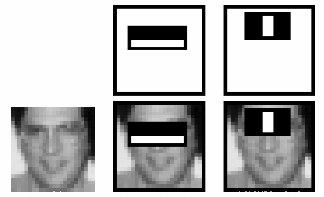
Approaches for Face Detection
Haar-feature classifier
Haar-feature is a predefined kernel used to detect lines and edges of contrasting intensity
Haar-feature classifier groups these into 'stages' and applies them to windows of the image
Windows passing all stages contain a facial landmark

Slide 7
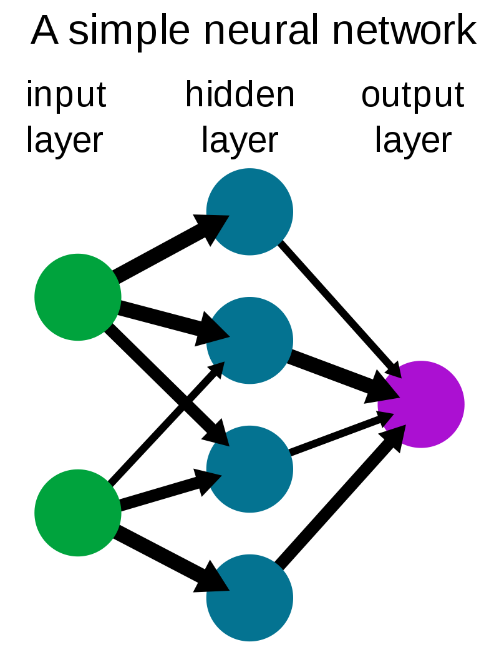
Approaches for Face Detection
Pass image through a Neural Network
Network of layers which uses weights to manipulate input data
During training, the layer weights are adjusted to provide the desired output.
To detect a face, we can feed in pixel data and get image location

Slide 8
Implementation: How it works
Obtains an image frame from the camera
Preprocess image
  Change size to that expected by the NN
  Convert to OpenCV's blob type
Blob provided as input data to the NN and forward pass is triggered
Output matrix is retrieved from the NN
Extract normalised bounding box position from matrix
Multiply normalised BB by original image width and height

Slide 9
Implementation: Successes
I was able to write a face detection program with Rust
The resulting implementation performs well
Was prompted to enforce error handling with matches
Wealth of documentation online was applicable due to one-to-one mapping of methods
Feasible to port Python/C++ OpenCV application to Rust

Slide 10
Implementation: Problems I encountered
Interface is not entirely consistent across Python/C++/Rust
OpenCV has specific types (converted to traits) for output from functions.
Resultant code was very coupled to the neural net model used.
Rust's syntax made these problems very obvious

Slide 11
Integration into the game
Packaged Face detection into a crate f-trak
Game runs f-trak in a separate thread
Game retrieves bounding box data via channels (rust-book chapter 16.2)
Bounding box mapped to game coordinate system
Player X position set to the X position of scaled bounding box centre point

Slide 12
Let's see it running!

Slide 13

Questions
References available in accompanying notes

